Slide 1

COUPON
SAVE
$10

Slide 2






[0, 1]
Cust. Segment 14
DM type 1
[0, 1]
Cust. Segment 7
DM type 2
[0, 1]
Cust. Segment 4
DM type 3
Cust. Segment 1

Slide 3
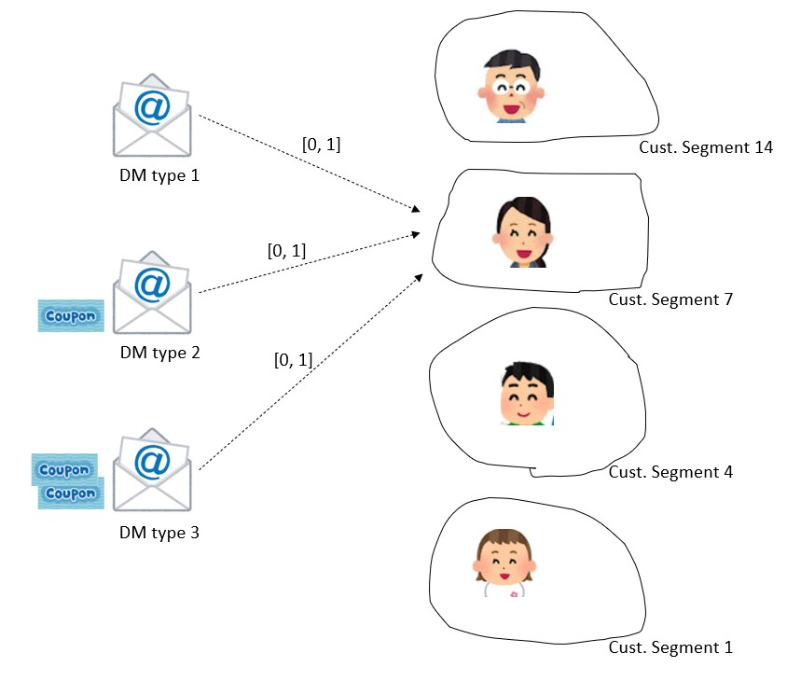


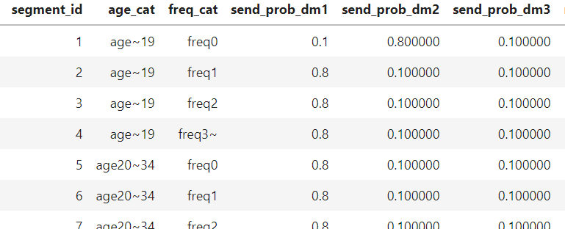
Python Pulp library
DM promotion budget
Optimizer of mail distribution to maximize the conversions
Best mail distribution plan
Revenue from more purchases

Slide 4
Diameter = 3.33
Diameter = 3.75
10
10
10
10

Slide 5
Customer Base Data
Segmentation
Causality analysis
Execute plan stochastically
Data Collection
Optimization
Optimized Coupon Plan
Real-world Coupon Response Outcome
Segment Probability Data

